Slide 1


National Basketball Association (NBA) “Who’s worth their salt?”
OR-603 Group Project
Prof: Mr. Brian Burke
Srashti Agrawal || William Cimino
2-May 2019

Slide 2
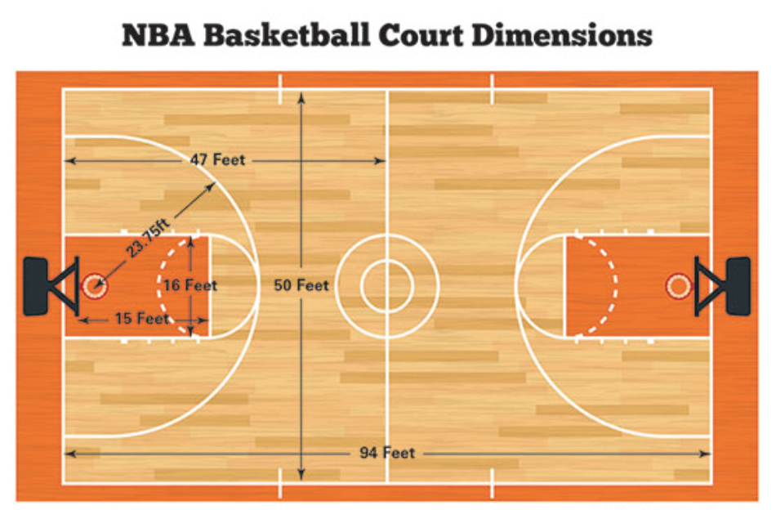

Agenda
Introduction
General Methodology
Sources of Data
Results
Conclusion
30 teams .. 10 players (5 x 5) .. 4 x 12min = 48min of game play .. 82 games in a season
Point Guard (PG), Shooting Guard (SG), Small Forward (SF), Power Forward (PF), Center (C)

Slide 3
Introduction
Research Question
“Do the top NBA basketball players underperform or overperform relative to their peers when comparing annual salaries to statistical game performance?”
Perspective data (2017-18 season)
$99.1M salary cap per team
NBA league salary cap was just under $3.0B
Average player salary was about $6.5M ($1,651.42 per min*)
*3,936 minutes in a season (82 games x 48 min)
Notes:
Our main research question is “Do the top National Basketball Association (NBA) basketball players underperform or overperform relative to their peers when comparing annual salaries to statistical game performance?”
We thought that this type of research question would be both relevant and interesting because player value is a key topic for any professional sports league as teams simultaneously deal with salary cap limitations and maximizing player value. Salary caps for a season represent the maximum amount of money a team can spend on salaries and incentives for the players. In the NBA, for example, the salary cap for the 2017-18 season was approximately $99.1M. Leading up to the 2017-18 season, the salary cap rose 1.09%, 7.47%, 11.00%, 34.49%, and 5.26% over the previous five years (Reference #1). Furthermore, with 30 teams of about 15 players each (458 players total players in the 2017-18 season), the NBA league salary cap was just under $3.0B and the average player salary was about $6.5M. In terms of maximizing player value, there are numerous examples of computing a player efficiency rating (aka PER) that can be combined with a players’ salary to determine the overall value. We computed overall value as the cost of a single unit of PER. To simplify the computation of PER for this project, we used a straightforward (and simple) formula with predetermined league “weights” (Reference #2). As a result, the PER formula provides a single number (PER) for each player that we can divide into a players’ salary (expressed for one minute of game play) to come up with the numeric value. For example, let’s compare two point guards (PGs). One is Stephen Curry (Golden State Warriors) with a $4,594.98 per minute played cost and a 29 PER, and the other is John Wall (Washington Wizards) with a $5,979.51 per minute played cost and a 26 PER. Given our premise, which one is perceived to be more valuable? The cost for one unit of PER is $158.45 ($4,594.98 / 29 PER) for Curry and $229.98 ($5,979.51 / 26 PER) for Wall. As a result, we would assess a higher value (lowest cost for one unit of PER) for Curry. To answer our research question, we compared a small sample (14-15) of players (by position) to the average for PER and value.

Slide 4
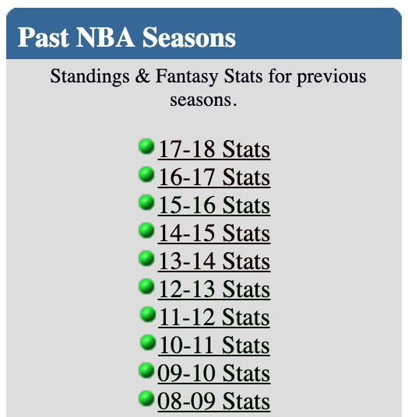
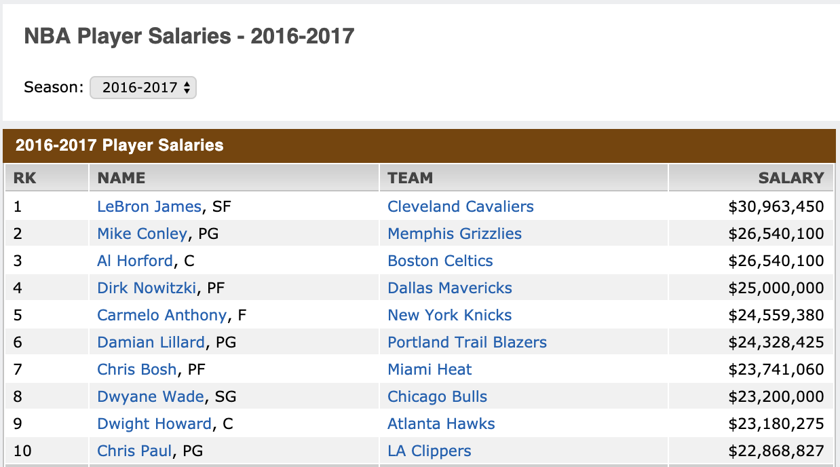
Sources of Data
“Past NBA Seasons”
“Doug’s NBA and MLB Statistics Home Page”
http://www.dougstats.com/index2.html
Past 30 seasons
Assume data is correct
“NBA Player Salaries”
http://www.espn.com/nba/salaries
Past 20 seasons
Assume data is correct
Notes:
Our team found two main sources of data that we thought worked well for this project. Both of the sources are briefly described below.
One source of data, labeled as “Past NBA Seasons” can be found on “Doug’s NBA and MLB Statistics Home Page” ( http://www.dougstats.com/index2.html ). On this website, 30 seasons (1988-1989 thru 2017-2018) of NBA data are available, which includes raw data (for every NBA player) and Top 10 Player Rankings for the following statistics.
Another source of data, labeled “NBA Player Salaries” can be found on ESPN ( http://www.espn.com/nba/salaries ) and includes player salary data, dating back to the 1999-2000 season. The data set includes a ranked list (by salary, highest to lowest) of players, the position they play, and their associated NBA team. For example, for the 2017-2018 season, Stephen Curry is ranked #1 with a salary of $37,457,154 or about 38% of the team’s salary cap. Wow!

Slide 5
General Methodology
Data Exploration and Evaluation
Combined data sets in Excel
Developed a visualization tool in R
Data Curation
Combined statistical data and salary, applied filter (e.g., +1500 points)
Created new calculations, computed PER, cost of PER
Information Extraction
Addressed the research question multiple samples
Visualizations
Created multiple visualizations to help in communicating the discoveries/results
Notes:
We used the following general, four-step methodology, explained below.
Data Exploration and Evaluation. To begin, we began to assemble parts of the “Past NBA Seasons” data set into Microsoft Excel to explore all the available data, and evaluate the usefulness and applicability against the research question. In parallel, we developed a visualization tool in R to make it much easier for the team to explore both individual and team statistical data. There are two examples provided below, which include evaluating the linear relationship between points and minutes played, highlighting Lebron James (PF) and Stephen Curry (PG), two well-known players.
Moving forward, we chose to focus on the last five full seasons (2013-2018) to get more familiar with the data and to “hone in” on answering our research question. To our surprise a lot of salary information was missing from the ESPN site. =)
Data Curation. As expected, combining all the relevant data into efficient data sets was definitely the most time-consuming process. In addition, there were several additional calculations that we needed to incorporate into the data set to calculate the PER value. These (new) calculations included defensive rebounds (total rebounds - offensive rebounds), missed free throws (free throws attempted - free throws made), and missed field goals (field goals attempted - field goals made). We also needed to match up PER to salary, which we computed as annual salary divided by total minutes played. To trim down the data set (with an eye on strong player performance and to save time), we made the decision to only include players with at least 1,500 points scored in a season. We also eliminated players with missing salary information (with the exception of the top 10 players, based on minutes played). During this phase of the methodology, we also made the decision to use both Excel and R (leveraging strengths in both), but agreed that we needed to stay coordinated regarding the core data sets, so we achieved consistent results.
Information Extraction. The “query-the-data-set” exercise to extract relevant information to determine favorable performance characteristics against the research question was mainly about exploring the seasonal data sets and “what if” scenarios. In addition, we also wanted to specifically address the research question with 14-15 players per season to easily assess the “underperform or overperform relative to their peers” piece of our research question.
Visualization. Our primary goal during this phase was the take the information extraction results and create multiple visualizations to help in explaining the results.

Slide 6
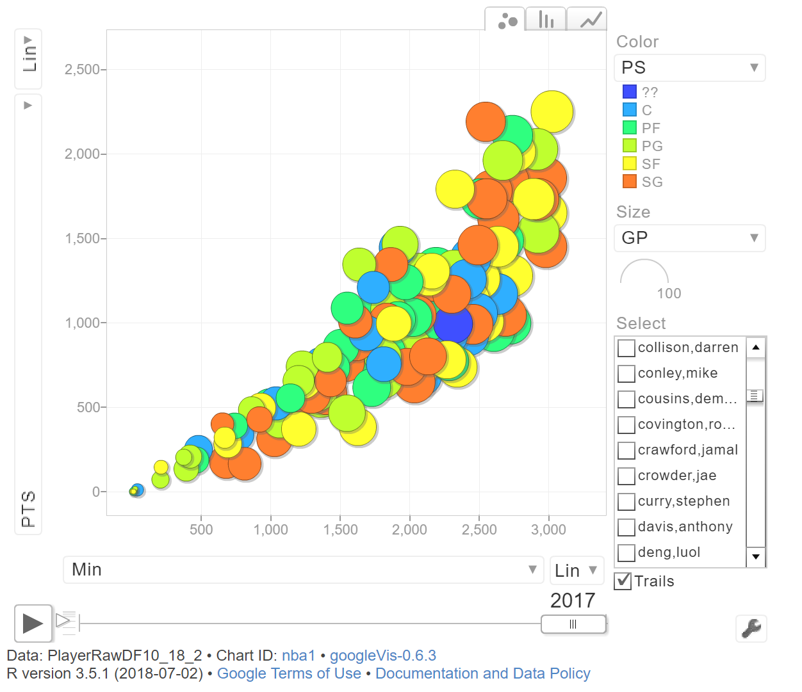
Data Exploration and Evaluation

Slide 7
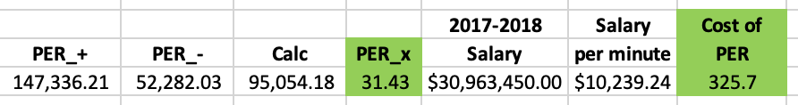
Data Curation (PER, Cost of PER)
League Weights
ADD
[ (FGM * 85.91) + (Steals * 53.897) + (3PTM * 51.757) + (FTM * 46.845) + (Blocks * 39.19) + (Offensive Rebounds * 39.19) + (Assists * 34.677) + (Defensive Rebounds * 14.707) ]
SUBTRACT
[ (Foul * 17.174) + (FT Miss * 20.091) + (FG Miss * 39.19) + (TO * 53.897) ]
MULTIPLY
(1 / Minutes)
Salary (per minute) / Player Efficient Rating (PER) = Cost of PER
Notes:
https://bleacherreport.com/articles/113144-cracking-the-code-how-to-calculate-hollingers-per-without-all-the-mess
Used predetermined league “weights”

Slide 8
Information Extraction
Computed, extracted relevant info to address research question with sample of 13-14 players per season (2017-2018 example is below)
Player | PER diff | Cost diff
middleton,khris (SF) | 3.9 | -183.3
brooks,dillon (SF) | -4.4 | -174.4
kuzma,kyle (PF) | -0.5 | -131.0
johnson,joe (SF) | -6.0 | -163.8
capela,clint (C) | 6.6 | -88.1
ferrell,yogi (PG) | -4.0 | -148.4
mitchell,donovan (SG) | 2.4 | -161.4
grant,jerami (SF) | 1.8 | -152.0
levert,caris (SG) | 0.4 | -159.6
rozier,terry (PG) | 0.0 | -136.3
holiday,jrue (PG) | 3.8 | 235.3
barnes,harrison (SF) | 2.3 | 292.1
smith,jr (SG) | -6.4 | 466.9
Player | PER diff | Cost diff
capela,clint (C) | 6.6 | -88.1
middleton,khris (SF) | 3.9 | -183.3
holiday,jrue (PG) | 3.8 | 235.3
mitchell,donovan (SG) | 2.4 | -161.4
barnes,harrison (SF) | 2.3 | 292.1
grant,jerami (SF) | 1.8 | -152.0
levert,caris (SG) | 0.4 | -159.6
rozier,terry (PG) | 0.0 | -136.3
kuzma,kyle (PF) | -0.5 | -131.0
ferrell,yogi (PG) | -4.0 | -148.4
brooks,dillon (SF) | -4.4 | -174.4
johnson,joe (SF) | -6.0 | -163.8
smith,jr (SG) | -6.4 | 466.9
Overperform
--Positive PER diff
--Negative Cost diff
Underperform
--Negative PER diff
--Positive Cost diff

Slide 9
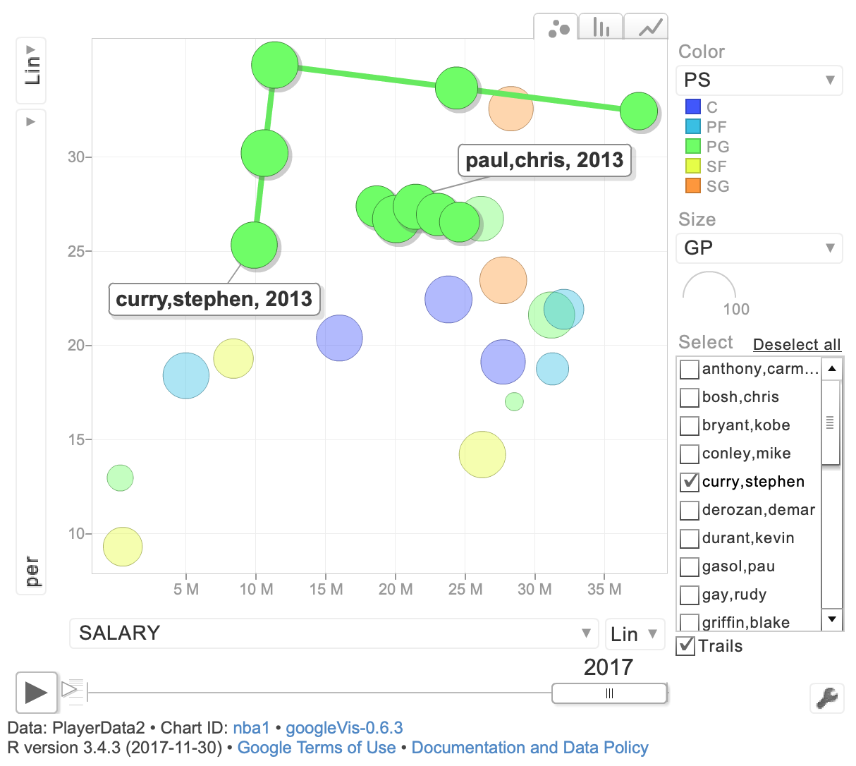


Visualizations – PER vs. Salary
Chris Paul
Houston
Rockets PG
Stephen Curry
Golden State
Warriors PG

Slide 10
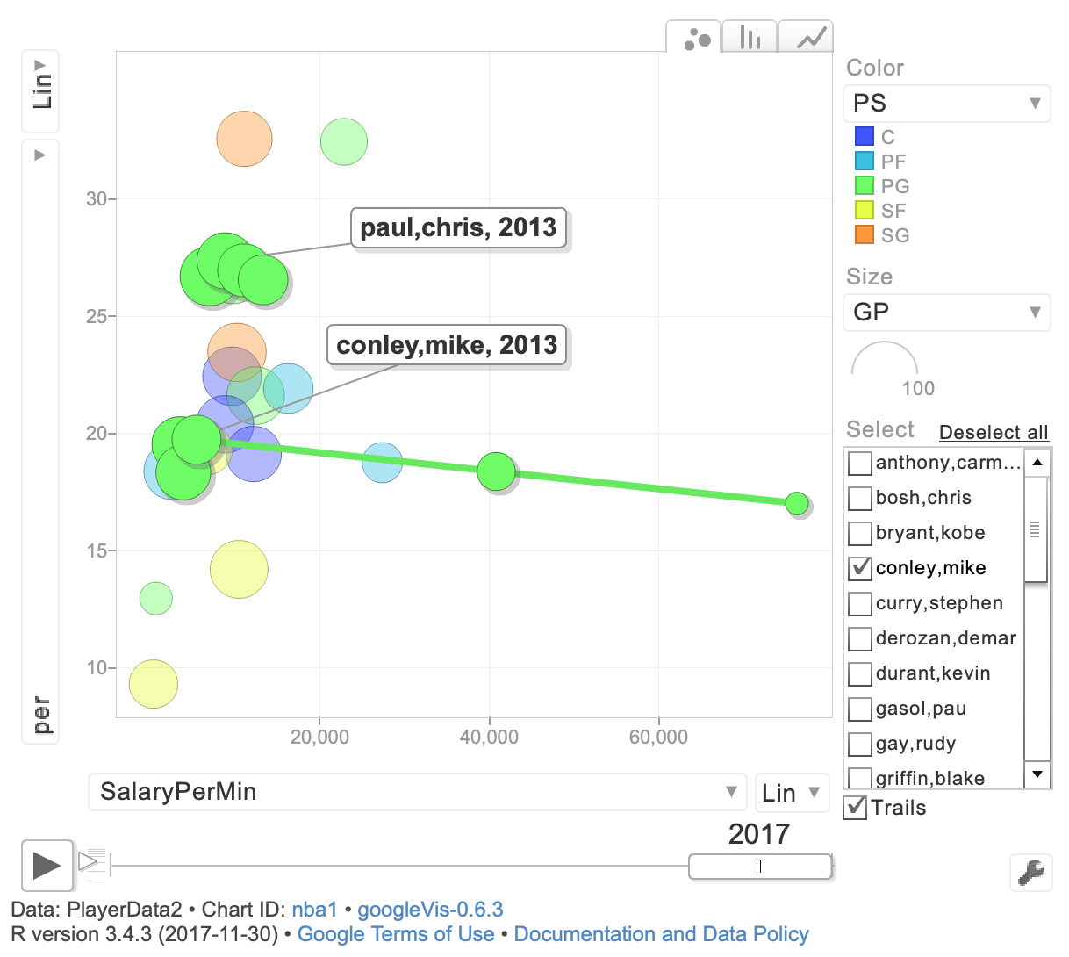

Visualizations – PER vs. Salary / Min
Chris Paul
Houston
Rockets PG
Mike Conley
Memphis Grizzlies PG

Slide 11
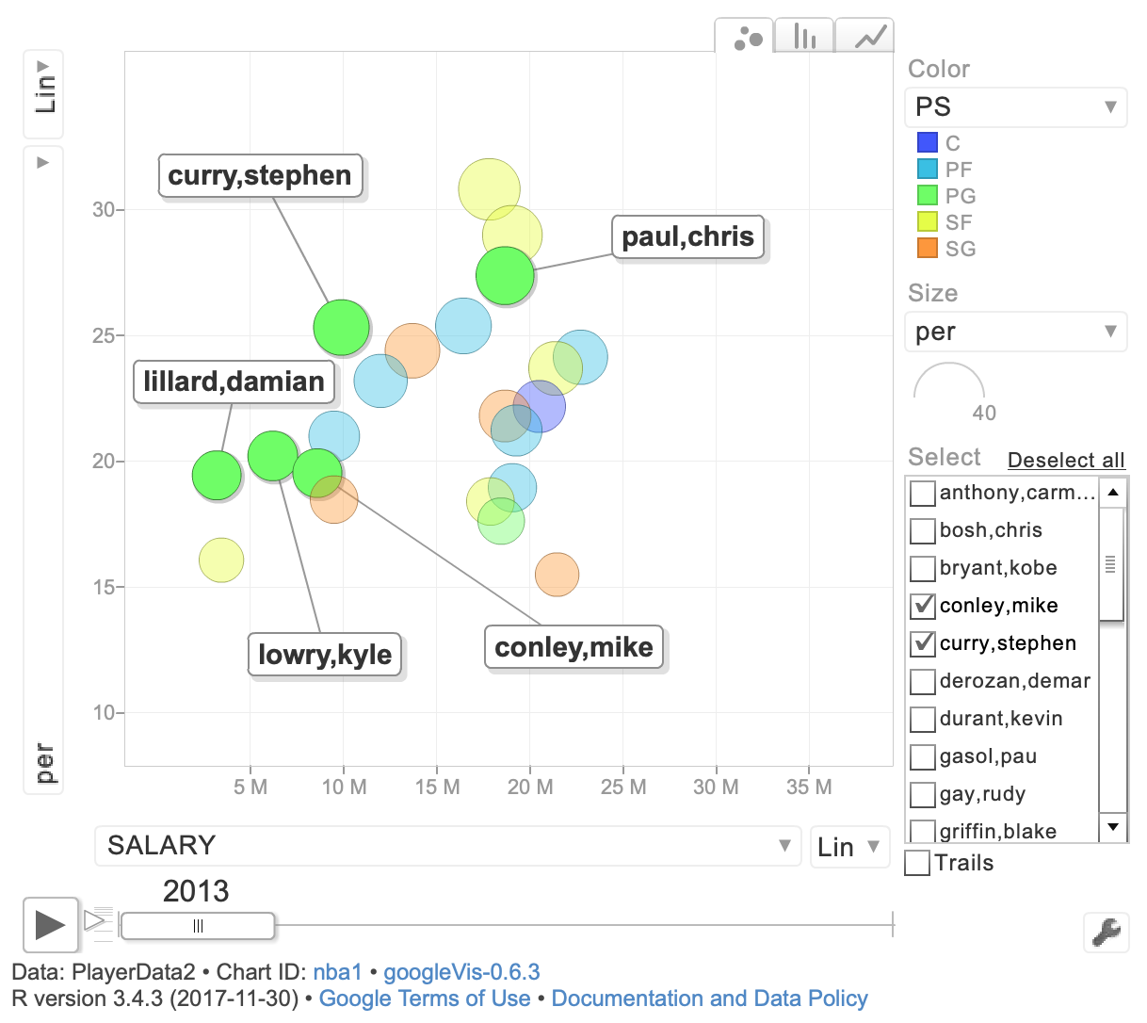
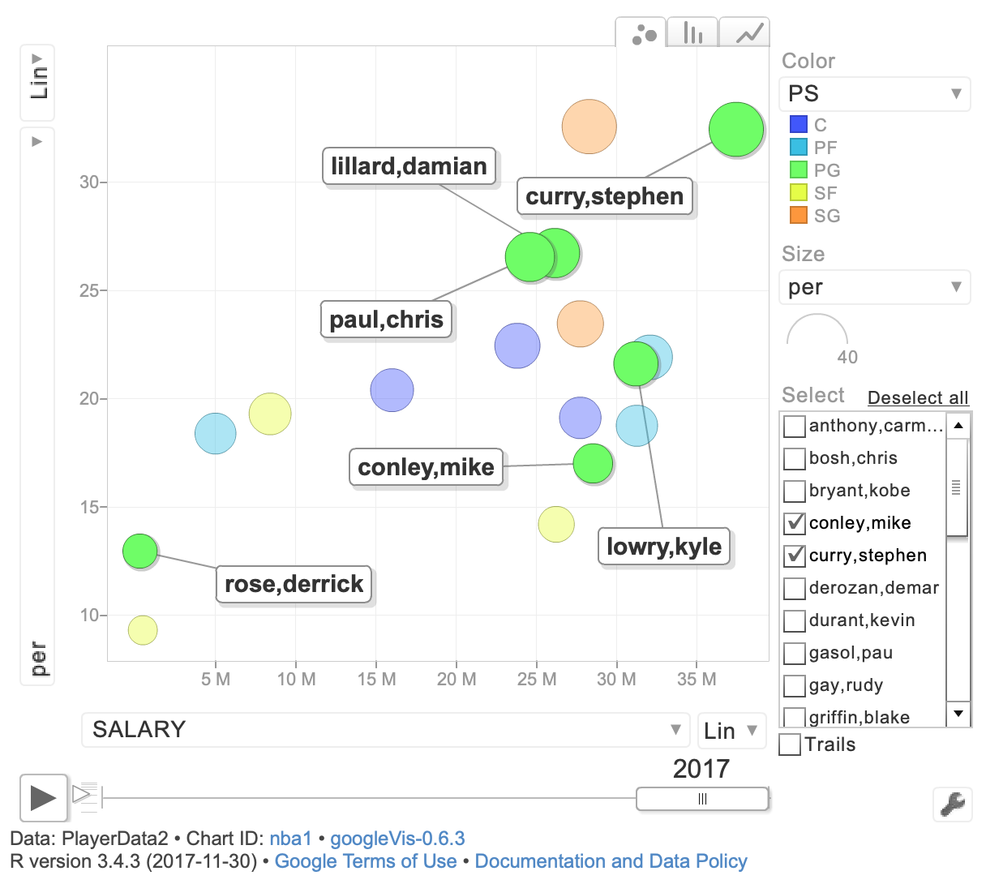
Visualizations – PER vs. Salary (PGs)

Slide 12
Results
Question – “Do the top NBA basketball players underperform or overperform relative to their peers when comparing annual salaries to statistical game performance?”
Answer(s) – Yes, we were able to prove both (over, under) cases
Compared two players
Compared multiple (beyond two) players
Compared players, based on PER, Salary averages (by position)

Slide 13
Conclusion
If we could repeat the project or there was additional time ..
Use a more complete data set (e.g., all salary info)
Look at 15-20 seasons, rather than just five
Compare all players to averages (by position) to determine under or over
Consider how injuries (i.e., sprained ankle, torn ACL) impact player participation
For follow-on research, we recommend
An increased focus on the player position (e.g., PG)
Addressing player value throughout contract (e.g., multi-year) w/r to salary cap
Building out predictive capability of evaluating under/over performance
Applying results to recommend/influence player draft and trade decisions
Expanding visualizations – apply ESPN’s Goldsberry’s “SprawlBall”* approach (next chart)
*29-April 2019 Washington Post article by Ben Strauss
Notes:
In conclusion, the results do in fact suggest that it’s possible to address our research question of “Do the top NBA basketball players underperform or overperform relative to their peers when comparing annual salaries to statistical game performance?”
If there was an opportunity to repeat the project or there was additional time, we would definitely want to work with a more complete data set. Our project team would want the data set to consist of all NBA players statistics and salary information. We would still limit the data set to include only players with a certain number of minutes played or points (e.g., 1,500). For follow-on research, we recommend focusing on the following five initiatives: 1) An increased focus on the player position (e.g., PG), 2) Addressing player value throughout contract (e.g., multi-year) w/r to salary cap, 3) Building out predictive capability of evaluating under/over performance, 4) Applying results to recommend/influence player draft and trade decisions, and 5) Expanding visualizations – apply ESPN’s Goldsberry’s “SprawlBall”* approach (next chart)
Primary References
1. http://www.dougstats.com/index2.html
2. http://www.espn.com/nba/salaries
3. https://www.basketball-reference.com/contracts/salary-cap-history.html
4. https://bleacherreport.com/articles/113144-cracking-the-code-how-to-calculate-hollingers-per-without-all-the-mess

Slide 14
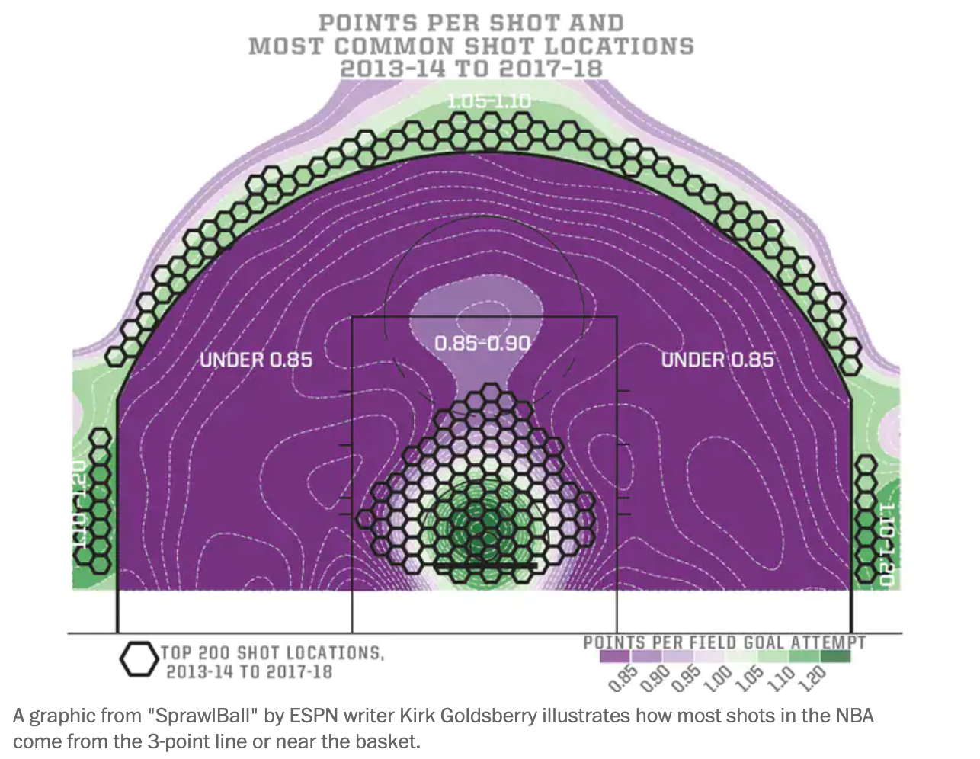
Fun Stats (2013-14 thru 2017-18 Seasons)

Slide 15

Thank you
Questions or Comments?

